Slide 1
5 / 2
Spotify Music Features
Chiou, Ching-Yi

Slide 2

Import Package
import pandas as pd
import numpy as np
import matplotlib.pyplot as plt
import seaborn as sns
import spotipy
import spotipy.util as util
pip install spotipy
Notes:
https://developer.spotify.com/documentation/general/guides/scopes/

Slide 3
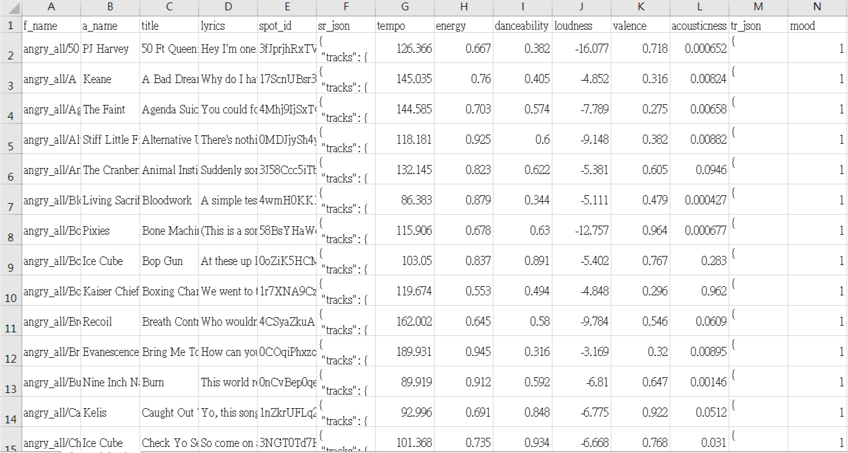
Training
使用csv來訓練情緒的分類
df_feature_selected = df.drop(['f_name', 'a_name', 'title', 'lyrics', 'spot_id', 'sr_json', 'tr_json', "mood"], axis=1)
Notes:
利用這個csv檔來訓練情緒的分類
那在寫code的時候，只會留下紅色框起來的部分，其他部分drop掉。

Slide 4
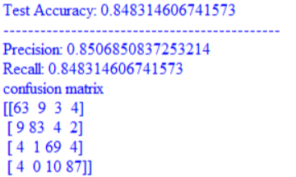
Fit to random forests
clf = RandomForestClassifier( min_samples_split=4, criterion="entropy" )
features_train, features_test, labels_train, labels_test = train_test_split( features, labels, test_size=0.20, random_state=91)
# find the accuracy of the model
try other classifier
kNN、SVM、Decision Tree
Notes:
計算屬性的gini(基尼不純度)還是entropy(信息增益)，，來選擇最合適的節點，預設是使用gini。
min_samples_split : 根據屬性劃分節點時，每個劃分最少的樣本數。
這個值限制了子樹繼續劃分的條件，如果某節點的樣本數少於min_samples_split，則不會繼續選擇最優特徵來進行劃分。 默認是2，如果樣本量不大，不需要管這個值。如果樣本量數量級非常大，最好是增大這個值。
Precision是在預測為Yes的個數中有多少實際也是Yes的。(模型的預測結果)
Recall是在實際為Yes的個數中有多少預測也是Yes的。(原本的樣本，又稱靈敏度sensitivity)

Slide 5
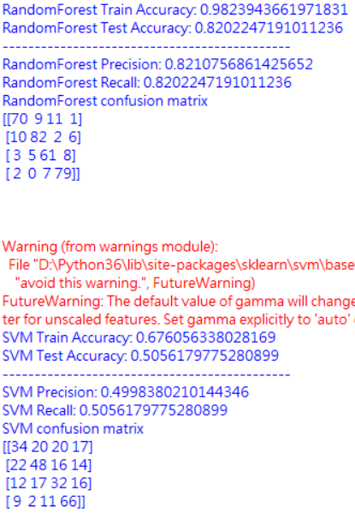
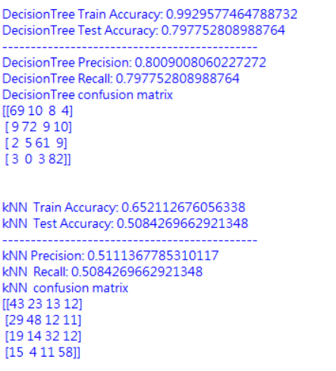
Try other classifier
Random Forest Classifier
Support Vector Machines, SVM
Decision Tree Classifier
K Nearest Neighbor, kNN
Notes:
compare classifier.py

Slide 6
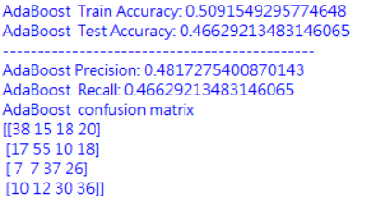
Try other classifier
AdaBoost Classifier

Slide 7
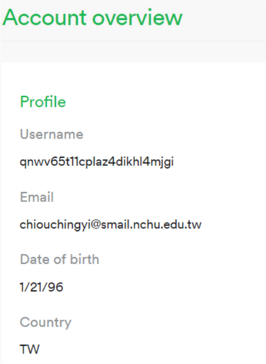
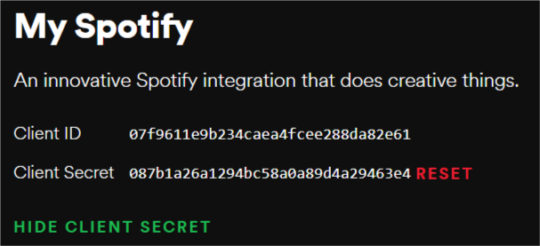
Predict New Music
# code for spotify get meta
username = 'qnwv65t11cplaz4dikhl4mjgi’
CLIENT_ID = '07f9611e9b234caea4fcee288da82e61'
CLIENT_SECRET = '087b1a26a1294bc58a0a89d4a29463e4'
REDIRECT_URI = 'http://localhost/'
SCOPE = 'user-library-read'
Notes:
spotify用戶頁面
https://www.spotify.com/sk/account/overview/?_ga=2.75840211.731393503.1551235253-649457457.1543405218
spotify dashboard
https://developer.spotify.com/dashboard/applications/56585547a2104e1bac19f149e1e3db0f
教學文件：
https://hackmd.io/HnG2jbsYTYKLacfu-ltdBQ?fbclid=IwAR11dbstHOF9ktxs0kdgydOXnT16YS6zL_bczwx-31LMnL0iuR8wJBvVG10

Slide 8
Predict New Music
Spotify Features
[{'danceability': 0.674,
'energy': 0.881,
'key': 9,
'loudness': -2.853,
'mode': 1,
'speechiness': 0.147,
'acousticness': 0.296,
'instrumentalness': 3.01e-06,
'liveness': 0.0793,
'valence': 0.234,
'tempo': 98.994,
'type': 'audio_features',
'id': '5WHTFyqSii0lmT9R21abT8',
'uri': 'spotify:track:5WHTFyqSii0lmT9R21abT8',
'track_href': 'https://api.spotify.com/v1/tracks/5WHTFyqSii0lmT9R21abT8',
'analysis_url': 'https://api.spotify.com/v1/audio-analysis/5WHTFyqSii0lmT9R21abT8',
'duration_ms': 178480,
'time_signature': 4}]
# 跳舞性 (tempo, rhythm stability, beat strength, and overall regularity)
# 強度
# 調性 (0 = C、1 = C♯/D♭、 2 = D …，沒偵測到=-1)
# 音軌的總響度(dB)
# 模式 (0=小調minor、1=大調major)
# 音軌中存在的口語單詞
# acoustic (0-1之間)
# 預測音軌包含人聲的程度
# 檢測錄製中是否有觀眾 (值越高代表是live)
# 音樂正向性 (值越高情緒越正面)
# bpm (每秒幾拍)
# 音樂ID
# 音樂uri
# 音軌時間長度(毫秒)
# 拍號 (每一小節有多少拍)
Notes:
https://developer.spotify.com/documentation/web-api/reference/tracks/get-audio-features/

Slide 9
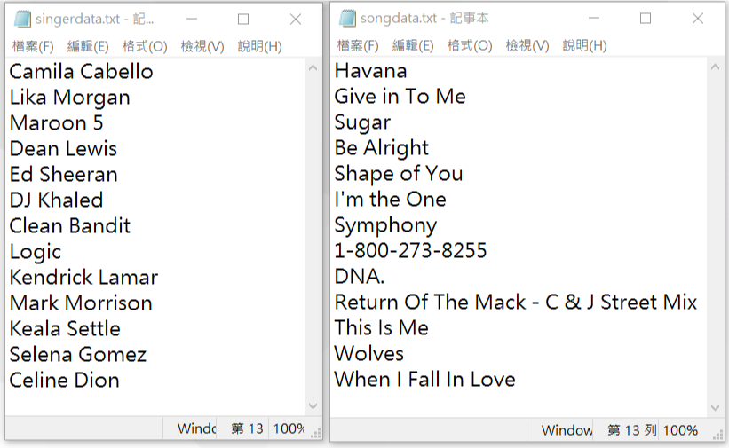
Predict New Music
Notes:
在測試的時候我以這些做測試，左邊的txt檔是歌手，右邊txt檔是歌名。

Slide 10
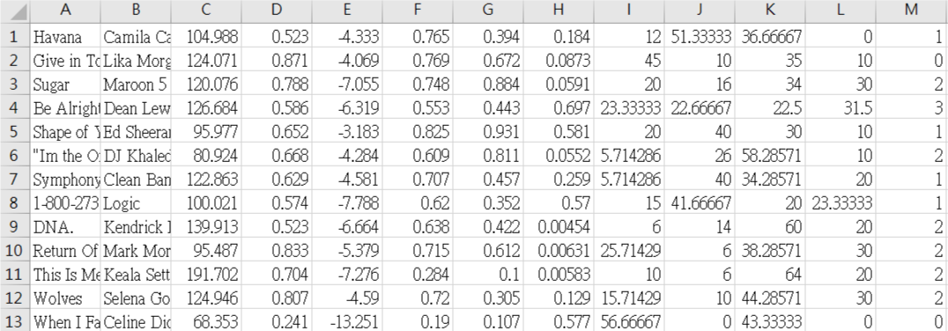
Predict New Music
Table = [['Song Name', 'Singer', 'tempo', 'energy', 'loudness', 'danceability', 'valence', 'acousticness', 'happy', 'angry', 'sad', 'relax', 'Mood Class']]
Song Name
Singer
6 features
percent of 4 emotion
emotion
result

Slide 11
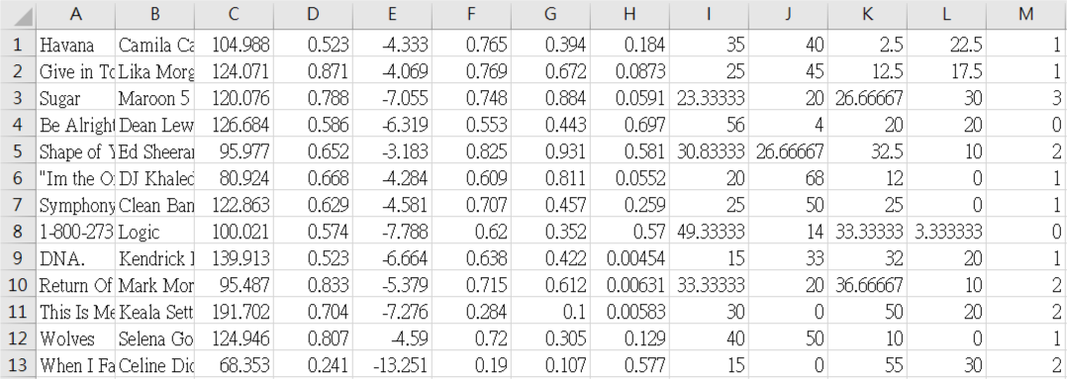
Problems
yourOutputTest.csv
yourOutputTest2.csv
解決：np.random.seed(1)
# 每一次跑出來都一樣
Notes:
我有發現一個問題，使用一樣的歌單，分別抓兩次特徵，但兩次分出來的結果差異有點大，所以我就沒辦法知道我自己建立的歌單，在4種情緒類別上分佈有沒有平均。

Slide 12
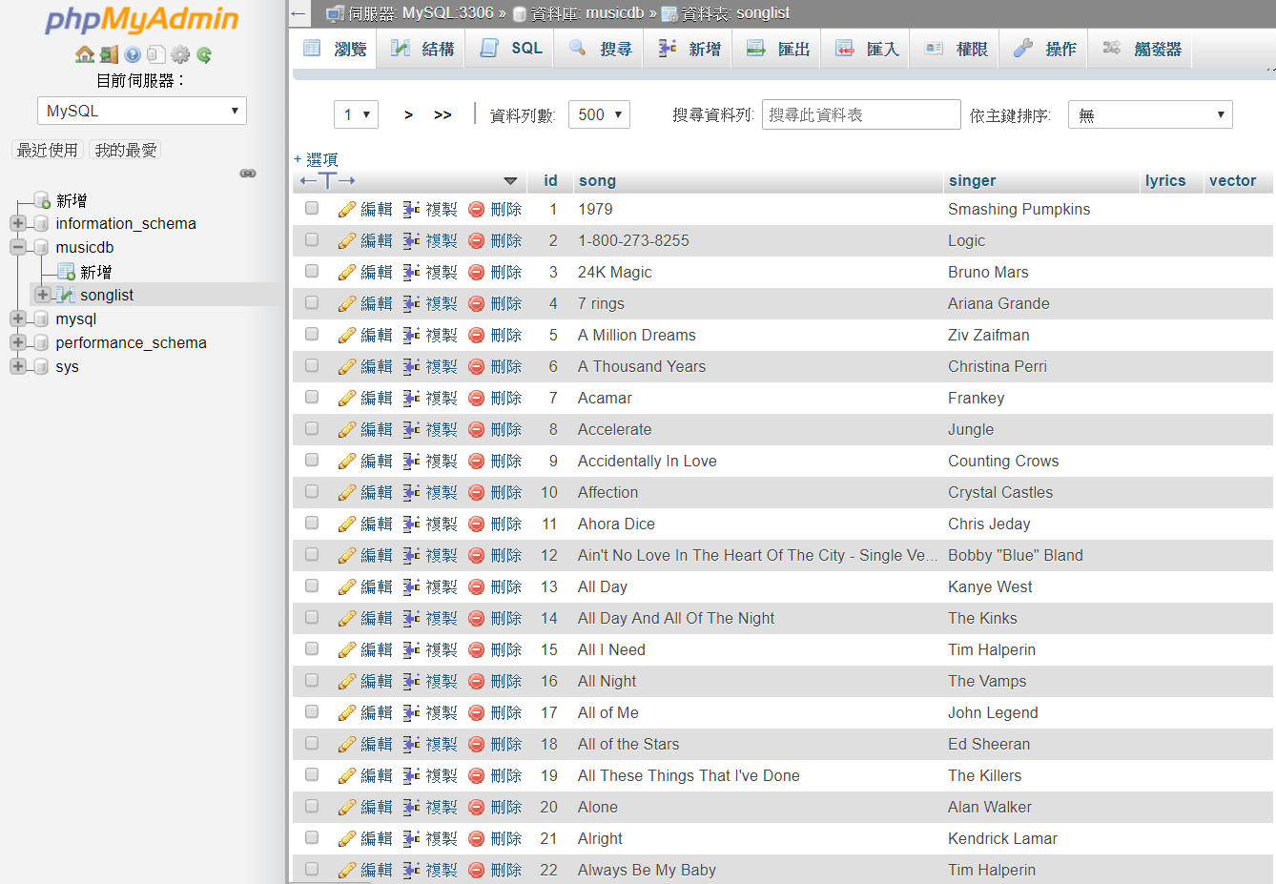
Music Dataset
Happy : 117
Angry : 134
Sad : 177
Relax : 122
Total : 550
yourOutput_0316.csv
Notes:
目前歌單的4種情緒分佈
happy情緒的歌曲不好找

Slide 13
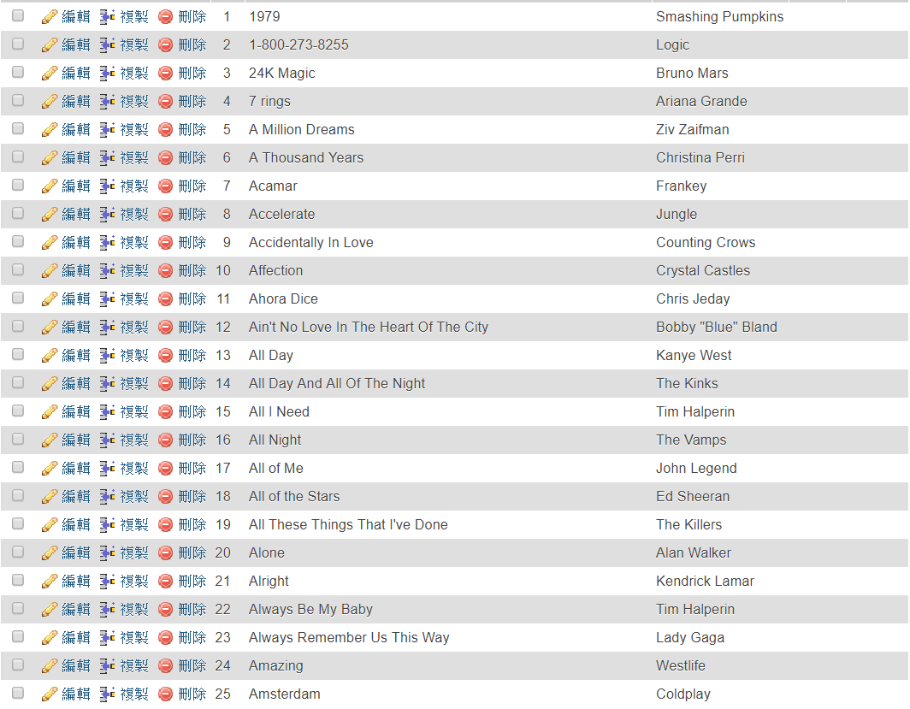
Music Dataset
songdata7_0408.txt
singerdata7_0408.txt
移除歌名有feat等等
yourOutput_0408.csv

Slide 14
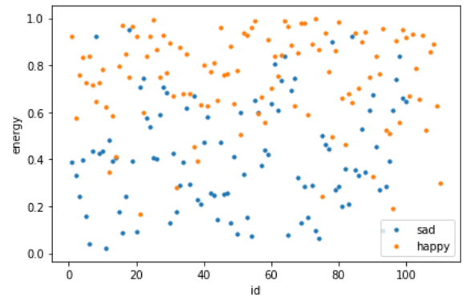
Features Analyze
happy → energy高 / sad → energy低
Notes:
happy → energy高

Slide 15
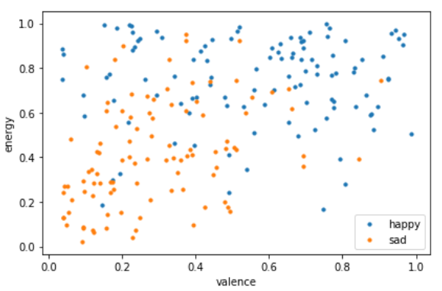
Features Analyze
sad → valence低、energy低
Notes:
sad → valence低、energy低

Slide 16
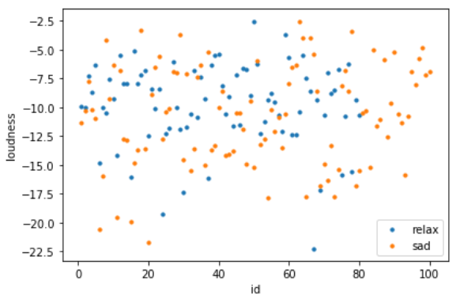
Features Analyze
relax → loudness大
Notes:
relax → loudness大

Slide 17
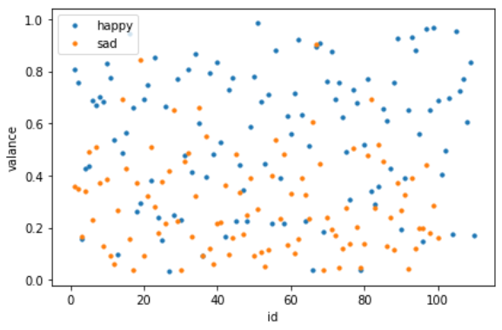
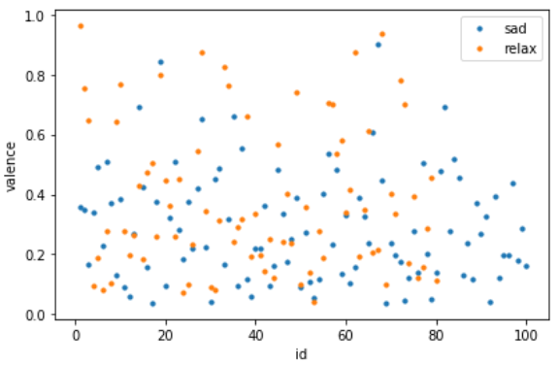
Features Analyze
sad → valence低
sad、relax → valence低
Notes:
sad → valence低

Slide 18
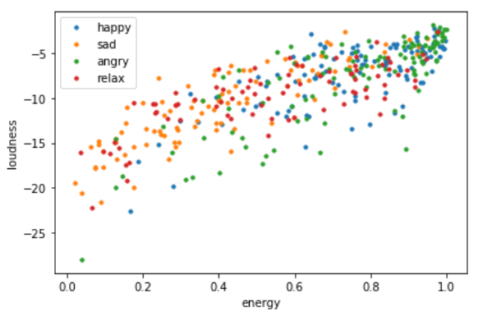
Features Analyze
happy、angry → energy高、loudness大
Notes:
happy、angry → energy高、loudness大

Slide 19
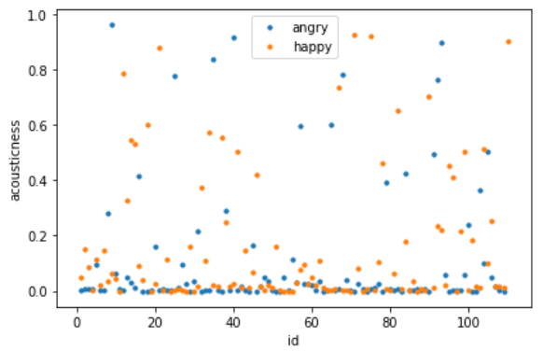
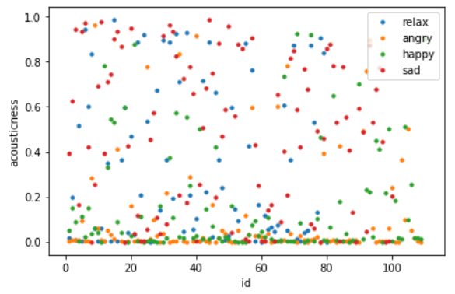
Features Analyze
angry、happy → acousticness低
Notes:
angry、happy → acousticness低

Slide 20
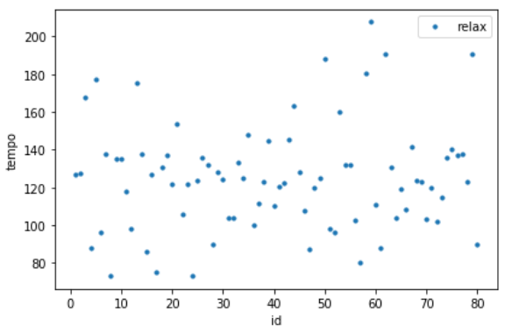
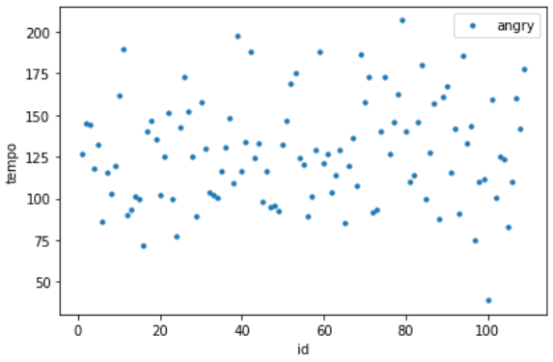
Features Analyze
relax → tempo(80-140) angry → tempo(100-175)
Notes:
relax → tempo(80-140)
angry → tempo(100-175)

Slide 21
Features Analyze
sad → valence低、energy低
relax → loudness大、tempo(80-140)
happy、angry → energy高、loudness大、 acousticness低
angry → tempo(100-175)
angry、happy 區分？
Notes:
relax → energy不明顯
sad → loudness不明顯
happy、sad → tempo不明顯
sad、relax → acousticness不明顯
happy、angry → valence不明顯

Slide 22
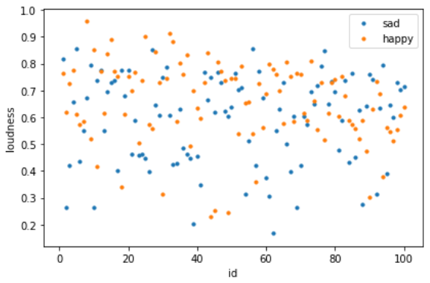
my dataset
Features Analyze
happy → loudness大
Notes:
happy → loudness大

Slide 23
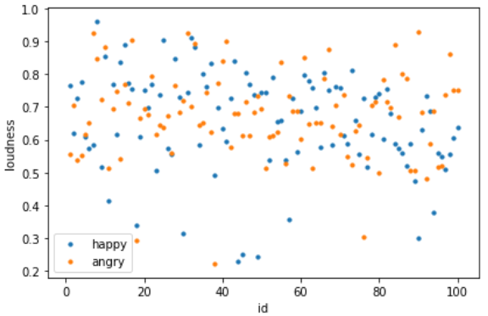
my dataset
Features Analyze
happy、angry → loudness大
Notes:
happy、angry → loudness大

Slide 24
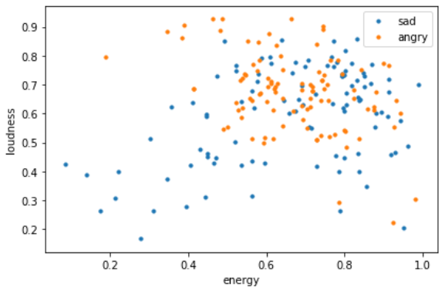
my dataset
Features Analyze
angry → energy高、loudness大
Notes:
angry → energy高、loudness大

Slide 25
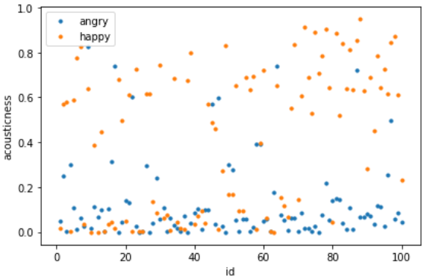
my dataset
Features Analyze
angry → acousticness低
Notes:
angry → acousticness低
acousticness : a confidence measure from 0.0 to 1.0 of whether the track is acoustic.
1.0 represents high confidence the track is acoustic.

Slide 26
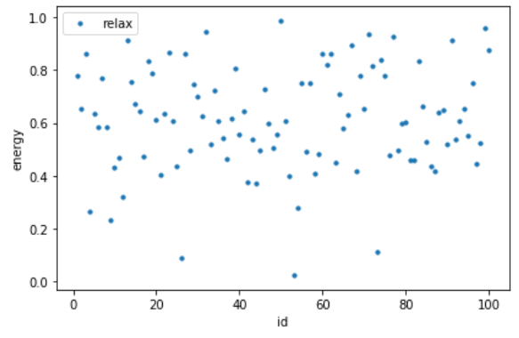
my dataset
Features Analyze
relax → energy高
Notes:
relax → energy高

Slide 27
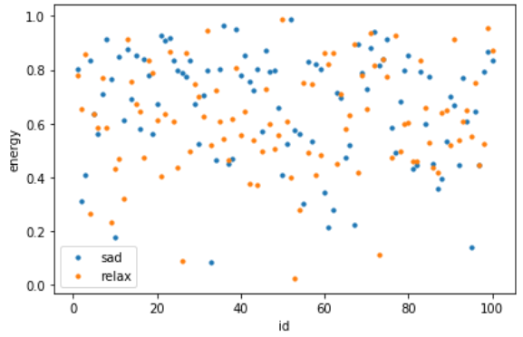
my dataset
Features Analyze
sad、relax → energy高
Notes:
sad、relax → energy高

Slide 28
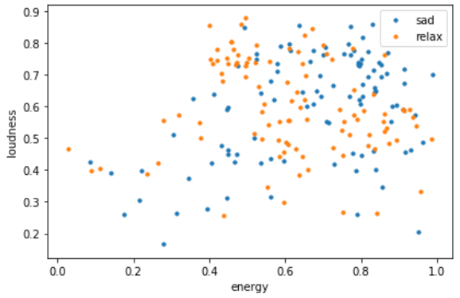
my dataset
Features Analyze
sad、relax → loudness大、energy高
Notes:
sad、relax → loudness大、energy高

Slide 29
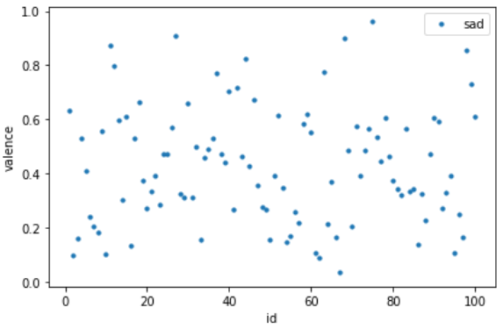
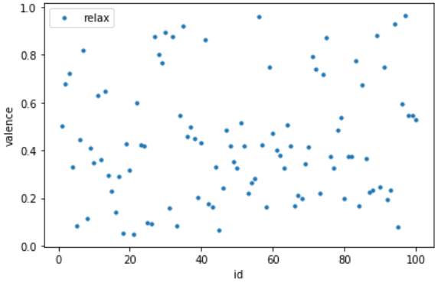
my dataset
Features Analyze
sad → valence (0.2~0.6) relax → valence (0.0~0.5)
Notes:
sad → valence (0.2~0.6)
relax → valence (0.0~0.5)

Slide 30
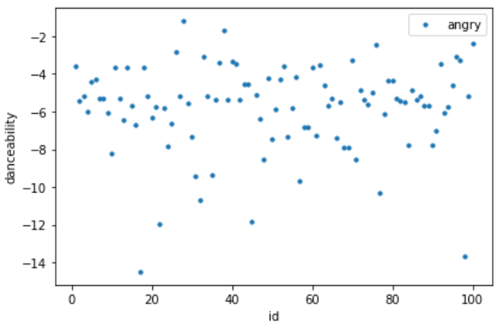
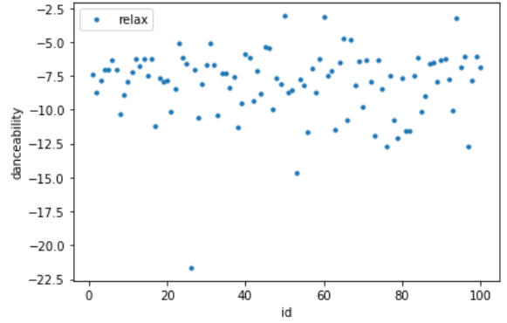
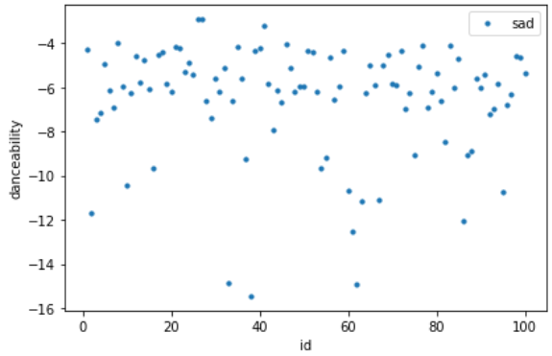
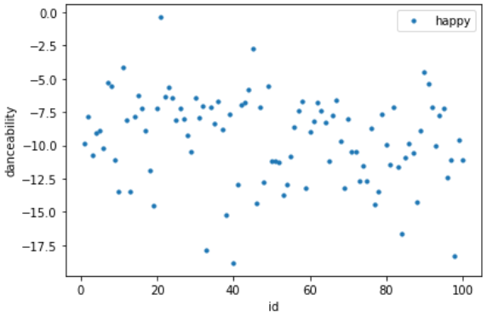
my dataset
Features Analyze
angry → danceability(-3.5~-8) / sad → danceability(-4~-8)
relax → danceability(-5~-11) / happy → danceability(-5~-15)
Notes:
angry → danceability(-3.5~-8) / sad → danceability(-4~-8)
relax → danceability(-5~-11) / happy → danceability(-5~-15)
Danceability describes how suitable a track is for dancing based on a combination of musical elements including tempo, rhythm stability, beat strength, and overall regularity.
A value of 0.0 is least danceable and 1.0 is most danceable.

Slide 31
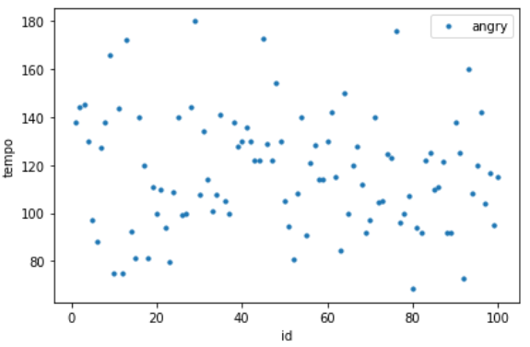
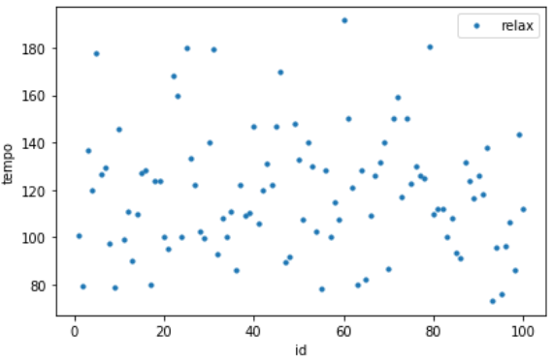
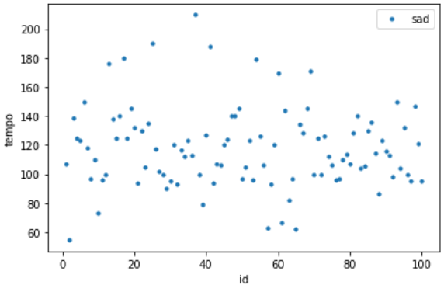
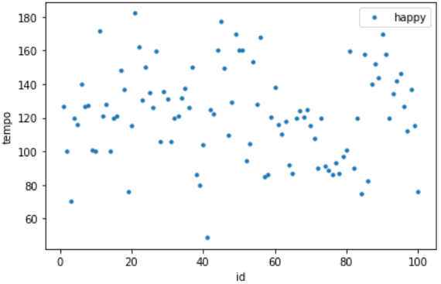
my dataset
Features Analyze
angry → tempo(90-150) / sad → tempo(80-150) / relax → tempo(90-150) / happy → tempo(100-160)
Notes:
angry → tempo(90-150)
sad → tempo(80-150)
relax → tempo(90-150)
happy → tempo(100-160)
tempo不太明顯

Slide 32
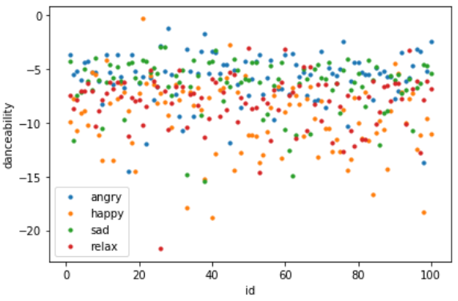
my dataset
Features Analyze
Notes:
較不明顯

Slide 33
my dataset
Features Analyze
happy、angry → loudness大 (✓)
angry → energy高、loudness大、acousticness低 (✓)
sad、relax → loudness大 (✓)、energy高
sad → valence (0.2~0.6)
relax → valence (0.0~0.5)
sad → valence低
relax → loudness大、tempo(80-140)
happy、angry → energy高、loudness大、 acousticness低
angry → tempo(100-175)
Notes:
happy → loudness大 (✓)
happy、angry → loudness大、acousticness低 (✓)
sad、relax → loudness大(✓)、energy高
sad → valence (0.2~0.6)
relax → valence (0.0~0.5)
A measure from 0.0 to 1.0 describing the musical positiveness conveyed by a track.
Tracks with high valence sound more positive (e.g. happy, cheerful, euphoric), while tracks with low valence sound more negative (e.g. sad, depressed, angry).

Slide 34
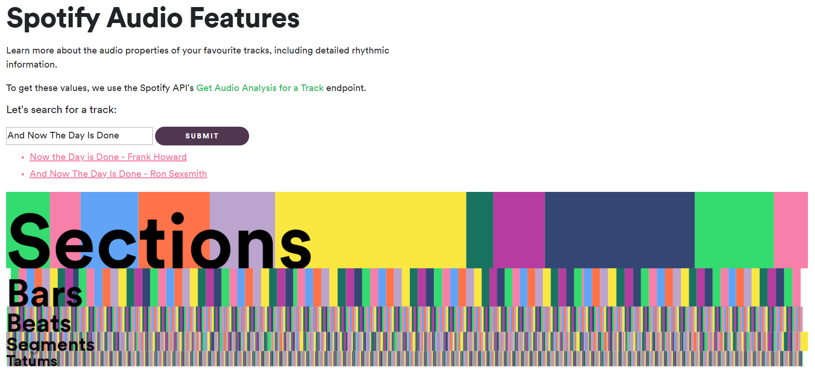
Spotify切割區段
Notes:
https://developer.spotify.com/documentation/web-api/reference/tracks/get-audio-analysis/
https://developer.spotify.com/console/get-audio-analysis-track/?id=06AKEBrKUckW0KREUWRnvT

Slide 35
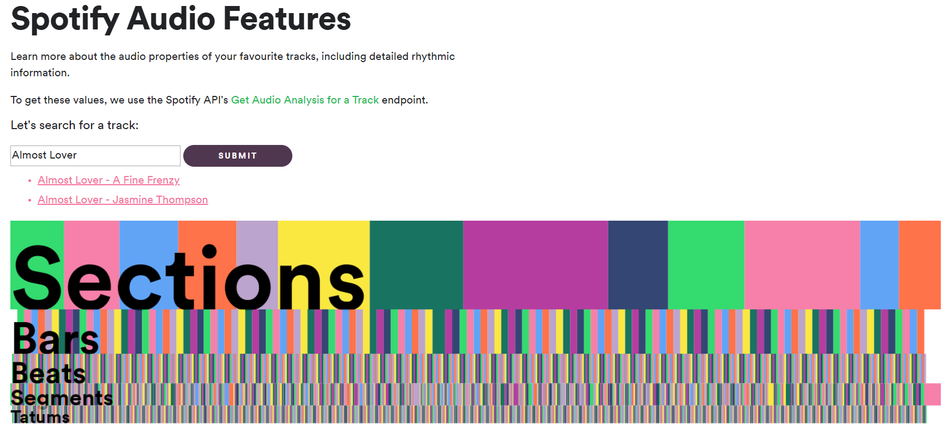
Spotify切割區段

Slide 36
Spotify切割區段 - Audio Analysis Object
KEY | VALUE TYPE | VALUE DESCRIPTION
bars | an array of time interval objects | The time intervals of the bars throughout the track. A bar (or measure) is a segment of time defined as a given number of beats. Bar offsets also indicate downbeats, the first beat of the measure.
beats | an array of time interval objects | The time intervals of beats throughout the track. A beat is the basic time unit of a piece of music; for example, each tick of a metronome. Beats are typically multiples of tatums.
sections | an array of section objects | Sections are defined by large variations in rhythm or timbre, e.g. chorus, verse, bridge, guitar solo, etc. Each section contains its own descriptions of tempo, key, mode, time_signature, and loudness.
segments | an array of segment objects | Audio segments attempts to subdivide a song into many segments, with each segment containing a roughly consitent sound throughout its duration.
tatums | an array of time interval objects | A tatum represents the lowest regular pulse train that a listener intuitively infers from the timing of perceived musical events (segments). For more information about tatums.
Notes:
覺得可以使用sections的部分，看出段落。

Slide 37
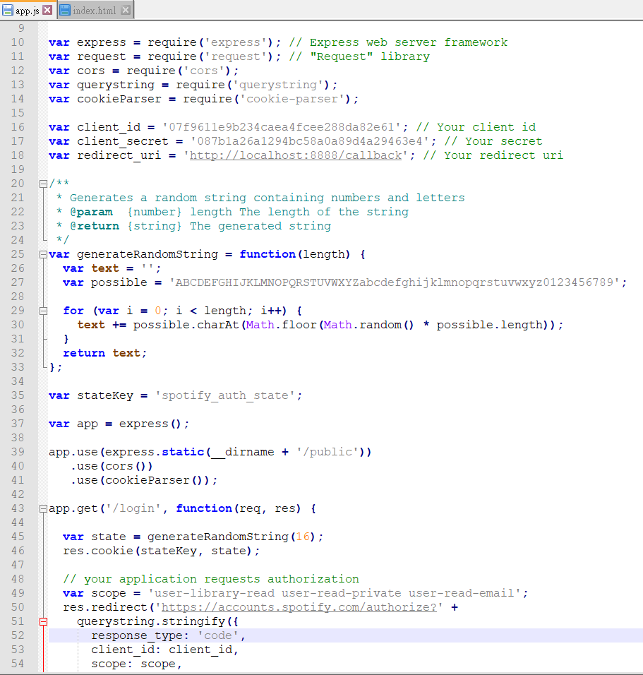
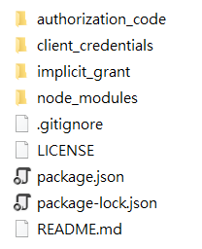

Spotify Accounts Authentication
Using your own credentials
download node.js
$λ$ npm install
Notes:
https://developer.spotify.com/documentation/web-api/quick-start/

Slide 38
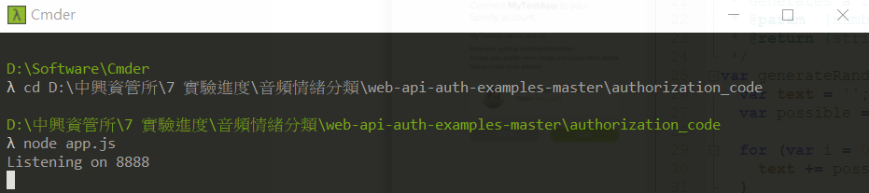

Spotify Accounts Authentication
$λ$ cd D:\中興資管所\7 實驗進度\音頻情緒分類\web-api-auth-examples-master\authorization_code
$λ$ node app.js

Slide 39
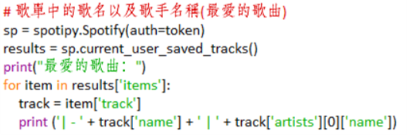
current_user_saved_tracks()
print the track that the user saved
Notes:
印出用戶收藏的歌曲

Slide 40
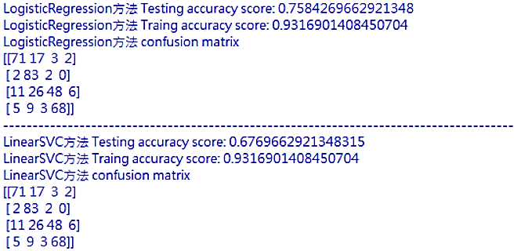
lyrics emotion
# LogisticRegression方法
# LinearSVC方法
Notes:
compare classifier(t).py

Slide 41
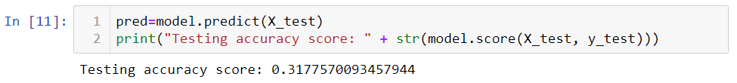
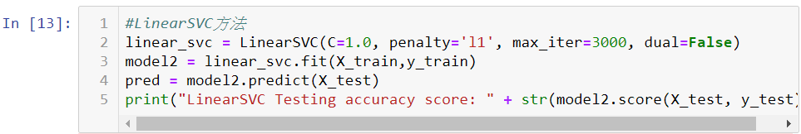
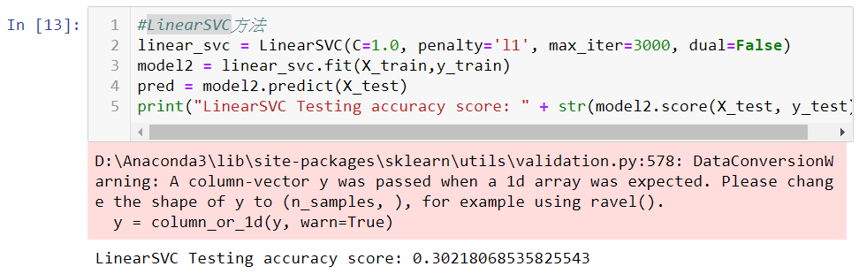
lyrics emotion
# LogisticRegression方法
# LinearSVC方法
lyrics0426(1-1071)_d.csv
Notes:
歌詞doc2vec結果：songlist_combine3.csv (目前只抓到1901首有歌詞)
抓取音樂特徵結果：combine(2000)0426.csv
文字情緒：先跑1071之前的 (後面順序亂了)
實際跑了1067首(去掉空值)
t_fier_new3.ipynb

Slide 42

user_playlists()
read the playlist of the user JennyChiouChiou, also can print the content of the playlist
Notes:
讀取使用者JennyChiouChiou的播放清單，也可印出播放清單之內容

Slide 43


Framework
$[A_{h},A_{a}$,$A_{r},A_{s},W_{h}\text{,}W_{a},W_{r}\text{,}W_{s},…other features…]$
feature selection
4 emotion probability
(happy/angry/relax/sad)
music
extract
audio
features
emotion
($A_{h}$、$A_{a}$、$A_{r}$、$A_{s}$)
song distance
song embedding
song coordinate
recommendation
system
lyrics
extract
word
features
emotion
($W_{h}$、$W_{a}$、$W_{r}$、$W_{s}$)
user embedding
user
survey
survey
result
convert to vector
(user-music-score)
recommended
music list
feedback
optimization system (reinforcement learning)
Go back to the adjustment algorithm after getting the user's feedback
Notes:
一開始會把歌曲做embedding，分別針對音頻和歌詞的部分，分別都會題曲到它的features，那就會利用這些features去做情緒分類，情緒有分成4種(happy/angry/relax/sad)，最後會分別得到4種情緒的機率值，歌詞部分也是一樣，看起來像是把音樂的情緒做分類，但真正的目的是要把它在音樂4個情緒上的機率值是多少跟歌詞4個情緒上的機率值是多少，把這兩個concate在一起來代表一首歌，利用這個技巧把它做出一首歌的特徵。用情緒的四個維度找歌曲的位置(這首歌在4個維度比較偏向在哪個區域)，從4個維度中看出歌跟歌之間的距離(座標上的距離) ，也可以自行加入其他的features，像是能量、節拍之類features進來，features太多就會做feature selection，看哪些是最有代表性的，挑選說哪些feature對我們比較有用，比較有用是指說對User推薦比較有用的，另外因為這些取到的值的值域沒有一致，所以可能到時候要考慮怎麼正規化到0-1之間。
User的部分，要怎麼知道用戶喜歡的是什麼，那就要透過survey做調查的方式，一般user要提供多少的量來當作reference會比較OK，(google這篇可看看，使用強化學習取得user的feedback之後回去調整演算法)，接著把user做完的調察轉成結果向量，結果有包括用戶的資訊和被評分的音樂和評分，然後丟進推進系統裡。系統就會產生一份音樂的推薦清單，user就會給這推薦系統一個feedback，可以考慮使用強化學習的方法，首要解決的是要提供給系統user喜歡的音樂是哪幾首，要有分析的依據，或是可以加入用戶對某一首歌的播放頻率，定義一個播放頻率的公式，當作一個輸入，這些常聽的或許可以轉成強化學習的獎懲機制。
是有想過使用NN的方式自動去學用戶喜歡哪一部分多一點，例如可能是喜歡音樂是放鬆情緒多一點，但是歌詞可能要是快樂的多一點，音樂裡也是有衝突的，音樂快樂但是歌詞沒那麼快樂，每個人喜歡的樣子不一樣，可能要自己發現到說這個人它喜歡的是哪一種再加哪一種，權重就可以不用被定那麼死，大方向有4個維度，然後再去看相對位置，就不會被這情緒label綁死。
要怎麼計算user的初始值，這個user喜歡這4種情緒在哪裡(把用戶做完的調查，應該要怎麼在這座標軸上定義)，要想一個方法轉成向量(可以參考yahoo和google)。
1. 要取多少的量來當作reference(要給initial user多少首評分才夠)
2. 要怎麼把user做完的調察轉成向量 (user embedding，很多研究使用NN的方式，平台要不斷地蒐集user常聽的歌，還要自己定義聽的頻率轉換成一個輸入，像之前報的那篇頻率轉輸入的方法)
3. 優化系統的方法(強化學習)
將 Embedding 應用在 Yahoo Email 中的產品推薦
https://medium.com/@tengyuanchang/%E5%B0%87-embedding-%E6%87%89%E7%94%A8%E5%9C%A8-yahoo-email-%E4%B8%AD%E7%9A%84%E7%94%A2%E5%93%81%E6%8E%A8%E8%96%A6-79675b9fdc62?fbclid=IwAR1roIiz4Q5jRp9OSobaVkUnGd0Fo5kx33Xos9mXBffWc88SYTYfZWCAZTc

Slide 44
Survey Page
Enter your information
Username
Gender
Male
Female
Age
NEXT
Notes:
這邊是給user做survey的介面，一開始會輸入一些比較基本的資訊。
Youtaker音樂試聽(提供嵌入程式碼)
http://www.youtaker.com/video/svb5-a0e81be0578247d7bf665874264abc7585.html.%E9%88%B4%E8%81%B2%20-%20Alan%20Walker%20-%20Faded.html
Ionic 行動應用框架: Hybrid Apps開發系列之7.2：SideMenu側欄選單(Spotify歌曲試聽範例)
http://hybridap.blogspot.com/2015/05/hybrid-apps72sidemenuspotify.html

Slide 45

Survey Page
How many songs take as a reference ? (give several songs for initial user to rate)
Score the following songs according to your preferences
play for 30s
1
5
Music 1
Preferences List
Music 2
Music 5
5
Music 3
4
Music 3、Music 6、Music 8
Music 4
OK
3
Music 2、Music 7
Music 5
2
Music 4
Music 6
1
Music 1
Music 7
Music 8
data : user-music-score
Notes:
再來會給用戶一些歌曲讓用戶去評分對這首音樂的喜歡程度，目前暫定是使用李克特量表：非常不喜歡/不喜歡/普通/喜歡/非常喜歡，對應到1到5分。
給使用者評分的歌目前是設定4種情緒各兩首，那要給多少量的音樂來做評分，我還沒準確抓到，還在從文獻裡看說通常都用多少首來當作survey，多少的量才足以表現用戶的喜好。
選曲上可能會在這4種情緒上比較鮮明的音樂，讓使用者不會誤解或是不好判定這是什麼情緒的歌，喜惡的偏向和界限定的清楚，之後會比較好分。
Youtaker音樂試聽(提供嵌入程式碼)
http://www.youtaker.com/video/svb5-a0e81be0578247d7bf665874264abc7585.html.%E9%88%B4%E8%81%B2%20-%20Alan%20Walker%20-%20Faded.html
Ionic 行動應用框架: Hybrid Apps開發系列之7.2：SideMenu側欄選單(Spotify歌曲試聽範例)
http://hybridap.blogspot.com/2015/05/hybrid-apps72sidemenuspotify.html

Slide 46
Survey Page
Enter your information
Username
Gender
Male
Female
Age
Music Type
(Multi-Select)
Pop
Classical
Folk
Rock
Blues
Jazz
Metal
Electro
Spoken
NEXT
Notes:
這些音樂是要排行榜的歌曲?
喜好程度可以重複?
Youtaker音樂試聽(提供嵌入程式碼)
http://www.youtaker.com/video/svb5-a0e81be0578247d7bf665874264abc7585.html.%E9%88%B4%E8%81%B2%20-%20Alan%20Walker%20-%20Faded.html
Ionic 行動應用框架: Hybrid Apps開發系列之7.2：SideMenu側欄選單(Spotify歌曲試聽範例)
http://hybridap.blogspot.com/2015/05/hybrid-apps72sidemenuspotify.html

Slide 47


Slide 48


Slide 49

THANKS!
chiouchingyi@smail.nchu.edu.tw

